Slide 1

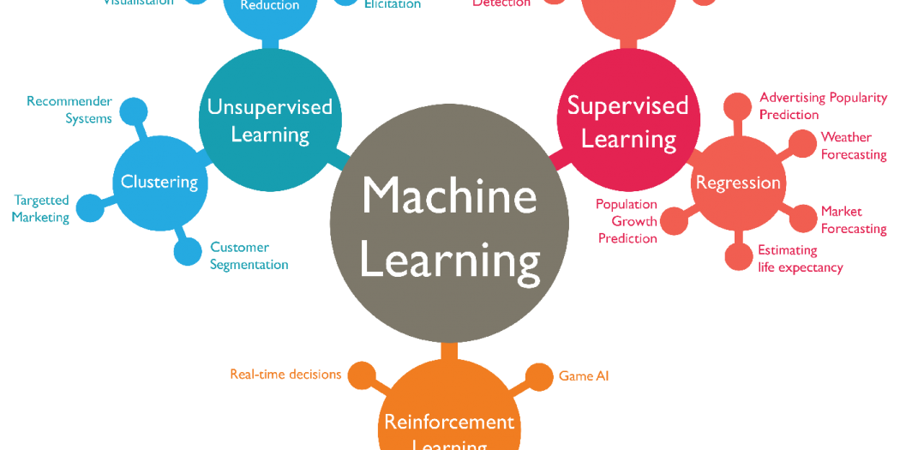



CSE 6363 MACHINE LEARNING
RESTAURANT REVIEW ANALYSIS
Devi Vara Prasad Rongala
Sowmya Kommabathula

Slide 2
TABLE OF CONTENTS
Introduction
Problem statement
Model 1 - Naive Bayes
Model 1 to Restaurant Review Analysis
Results
Visualization
Model 2 - Logistic Regression
Model 2 to Restaurant Review Analysis
Results
Visualization
Model 3 - Random Forest
Model 3 to Restaurant Analysis
Results
Visualization
Accuracy Score
Applications

Slide 3

INTRODUCTION
There are several methods to analyze customer reviews for a restaurant, such as Naive Bayes, Regression, and Random Forest. We will be using these three models to analyze restaurant reviews and will explain each model in subsequent slides. Afterwards, we will compare the accuracy scores of each model to determine which one is best suited for the chosen dataset. Finally, we will identify and present the best model for the given dataset

Slide 4

PROBLEM STATEMENT
Restaurant Review Analysis
We aim to build a Machine Learning model that can accurately detect the various sentiments expressed in a collection of English sentences or large paragraphs, such as reviews. The model's objective is to correctly identify the sentiment of users' reviews, which can be either positive or negative. Therefore, we will classify reviews as either positive or negative based on their sentiment.

Slide 5
DATASET
We have used the Data set from kaggle and below is the hyperlink to the data set
https://www.kaggle.com/datasets/hj5992/restaurantreviews?resource=download

Slide 6
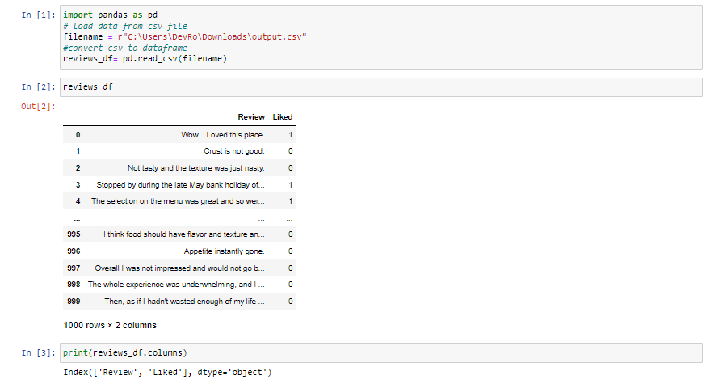
DATA PREPROCESSING
We created a data frame reviews_df that has the columns Review and Liked

Slide 7
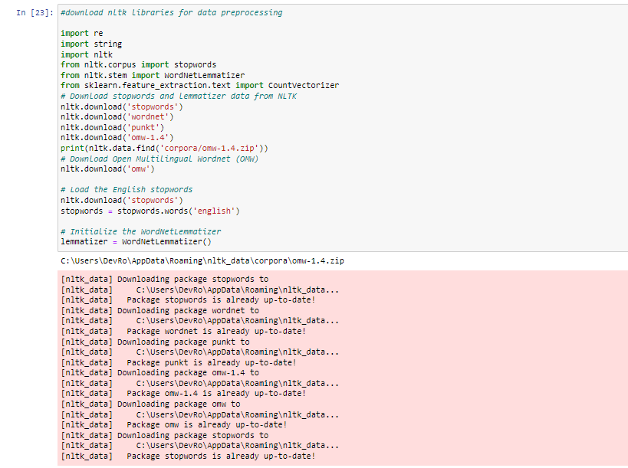
DATA PREPROCESSING
Download the data and libraries required for textual data preparation. It begins by loading the necessary libraries, including the CountVectorizer module from Scikit-learn, regular expression, string, and NLTK (Natural Language Toolkit), a toolkit for NLP (Natural Language Processing).The method then sets the English stopwords as a variable and downloads lemmatizer and stopword data from NLTK and Open Multilingual Wordnet (OMW). The WordNetLemmatizer, which is used to break down words into their root or base form, is then initialized.

Slide 8
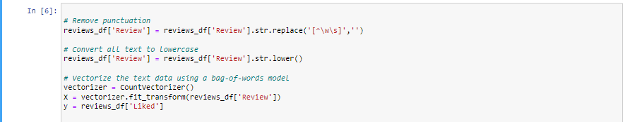
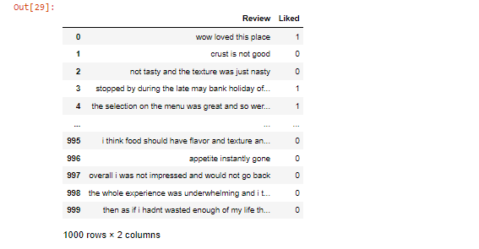
DATA PREPROCESSING
These code lines perform text preprocessing and vectorization on the Review column of the reviews_df dataframe.The first line removes all punctuation from the text using regular expression.The second line converts all text to lowercase using the .lower() method. This is done to standardize the text and ensure that uppercase and lowercase letters are treated as the same.The third and fourth lines vectorize the text data using a bag-of-words model. This converts the text data into a matrix of word counts, where each row corresponds to a review and each column corresponds to a unique word in the corpus. The resulting matrix can be used as input for various machine learning models.The figure shows output after this step.

Slide 9

MODEL 1: NAÏVE BAYES

Slide 10
Navie Bayes
The Naive Bayes classifier is a supervised machine learning algorithm, which is used for classification tasks, like text classification. It is also part of a family of generative learning algorithms, meaning that it seeks to model the distribution of inputs of a given class or category
Some best examples of the Naive Bayes Algorithm are sentimental analysis, classifying new articles, and spam filtration. Classification algorithms are used for categorizing new observations into predefined classes for the uninitiated data.

Slide 11
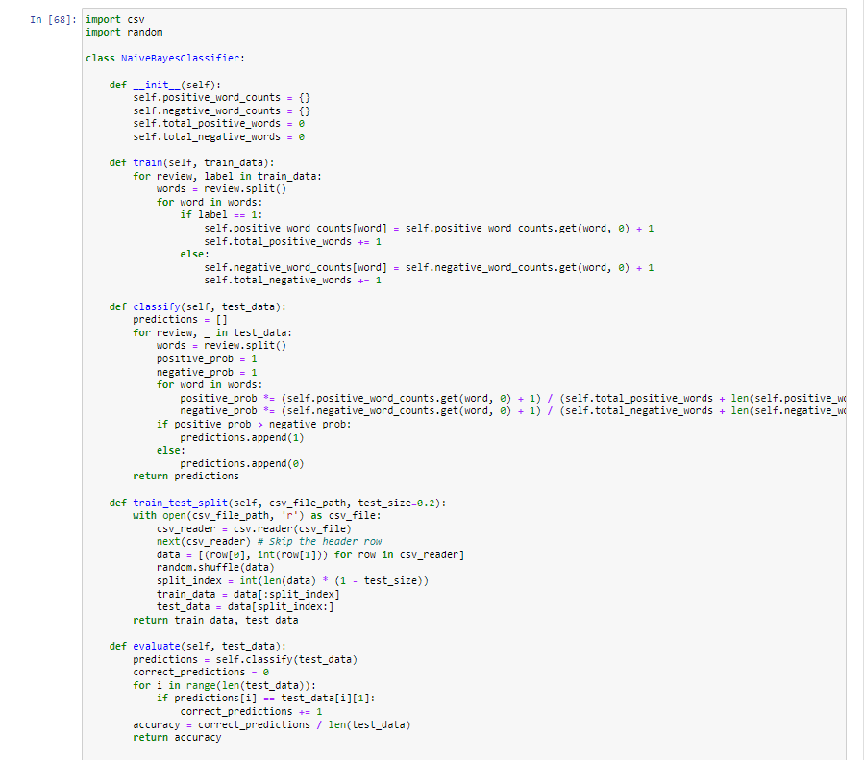
NAIVE BAYES

Slide 12

NaiveBayesClassifier(Methods)
__init__(self): Initializes the class by creating two empty dictionaries (positive_word_counts and negative_word_counts) and setting the counts of positive and negative words to 0.
train(self, train_data): Trains the Naive Bayes model on the given train_data. For each review in the train_data, it splits the review into words and updates the counts of each word in either the positive_word_counts or negative_word_counts dictionary depending on the label of the review.
classify(self, test_data): Classifies each review in the test_data using the trained Naive Bayes model. For each review, it splits the review into words and calculates the probability of the review being positive or negative based on the counts of each word in the positive_word_counts and negative_word_counts dictionaries. It then assigns a label of 1 if the probability of the review being positive is greater than the probability of the review being negative, otherwise it assigns a label of 0. The predicted labels are returned as a list.
train_test_split(self, csv_file_path, test_size=0.2): Splits the dataset in the csv_file_path into training and testing data. It reads the data from the csv file, skips the header row, shuffles the data, and splits it into training and testing data based on the test_size parameter. The training and testing data are returned as two separate lists.
evaluate(self, test_data): Evaluates the performance of the Naive Bayes model on the given test_data. It uses the classify method to predict the labels for the reviews in the test_data and compares them to the actual labels to calculate the accuracy of the model. The accuracy is returned as a float between 0 and 1.

Slide 13
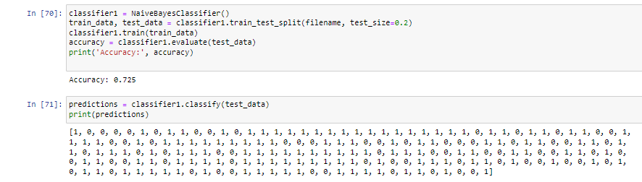
RESULTS
This code creates an instance of the NaiveBayesClassifier class, trains it on a dataset (80% as training data), evaluates its performance on a test set(20% test data), and prints the accuracy and predicted labels for the test set.We could see Accuracy is 72%

Slide 14
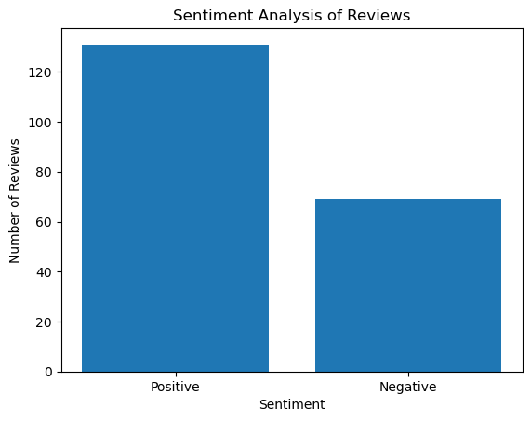
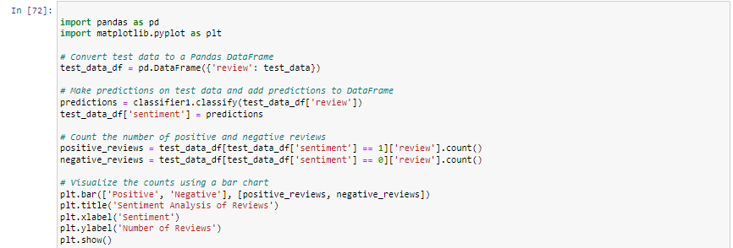
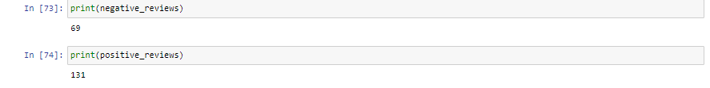
VISUALIZATION

Slide 15
MODEL 2 LOGISTIC REGRESSION

Slide 16
Logistic Regression
The type of statistical model is often used for classification and predictive analytics. Logistic regression estimates the probability of an event occurring, such as voted or didn't vote, based on a given dataset of independent variables.
Logistic regression is used to obtain odds ratio in the presence of more than one explanatory variable.

Slide 17
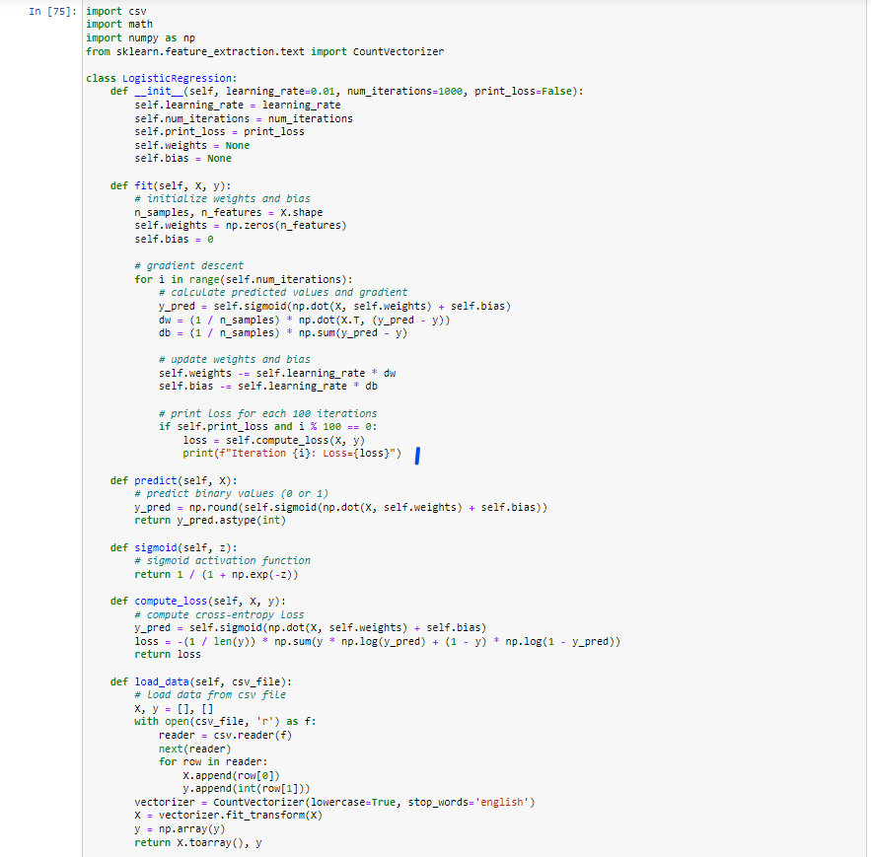
Logistic Regression

Slide 18
LogisticRegression Classifier
The __init__ method initializes the learning rate, number of iterations, and print loss parameters. The weights and bias are set to None initially.
The fit method performs gradient descent to train the logistic regression model. It takes two parameters, X and y, where X is a matrix of shape (n_samples, n_features) containing the input features and y is a vector of shape (n_samples,) containing the binary labels. The method initializes the weights and bias to 0 and then iteratively updates them based on the gradient of the loss function. The loss function used is the cross-entropy loss.
The predict method takes a matrix X of shape (n_samples, n_features) and returns a binary vector of shape (n_samples,) containing the predicted labels for each input sample.
The sigmoid method takes a vector z and applies the sigmoid activation function element-wise to produce a vector of the same shape.
The compute_loss method takes a matrix X of shape (n_samples, n_features) and a vector y of shape (n_samples,) and computes the cross-entropy loss for the current weights and bias.
The load_data method takes a CSV file path and loads the data into memory as input features X and binary labels y. The data is loaded using the csv module, and the input features are transformed using the CountVectorizer from sklearn.feature_extraction.text, which converts text into a bag-of-words representation.

Slide 19
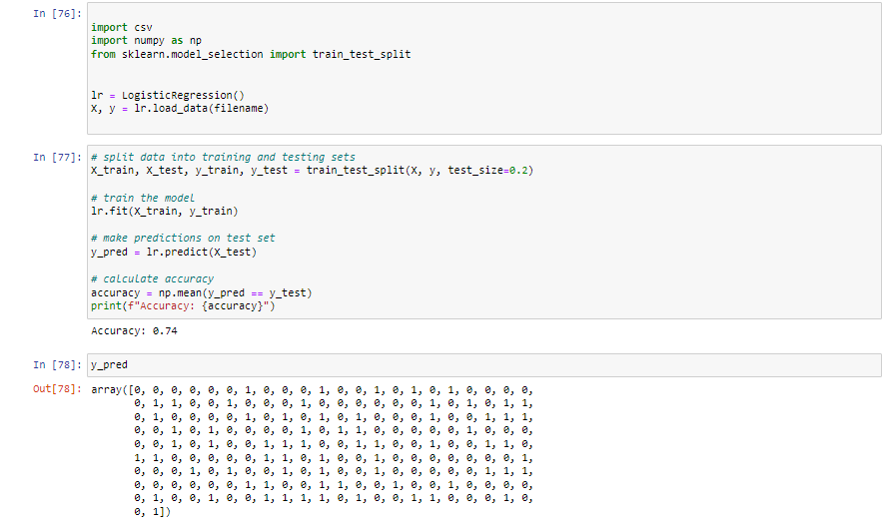
RESULTS
Trained a logistic regression model on our dataset loaded from a CSV file using the load_data method of the LogisticRegression class. The data is split into training and testing sets using the train_test_split function from the sklearn.model_selection module. The logistic regression model is trained on the training set using the fit method of the LogisticRegression class. The predict method is then used to make predictions on the test set, and the accuracy of the model is calculated as the proportion of correct predictions using the np.mean function. Finally, the accuracy is printed.We could see Accuracy is 74%

Slide 20
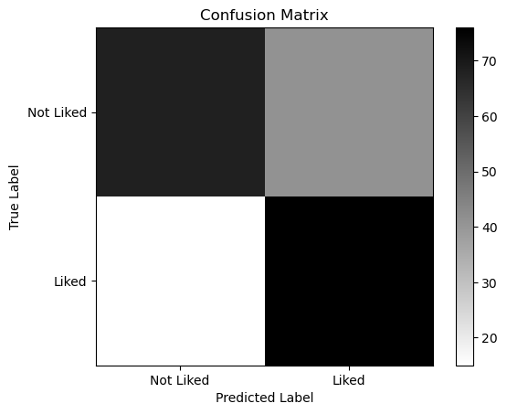
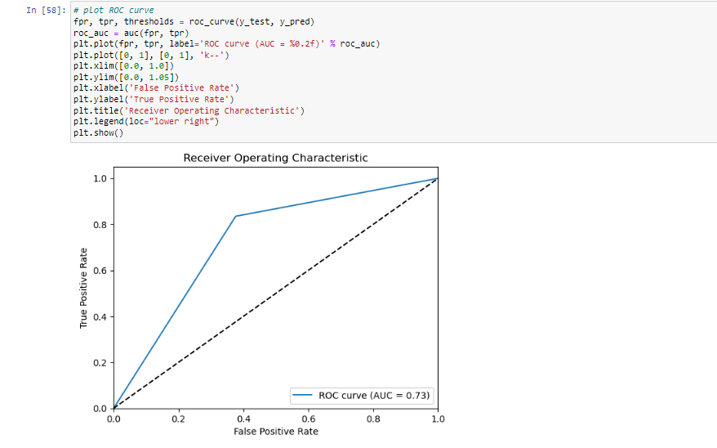
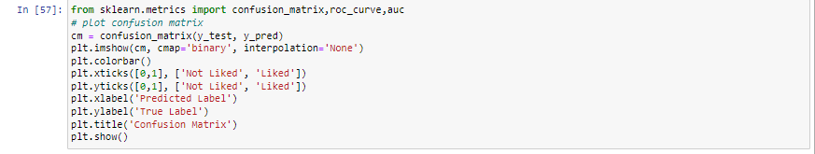
VISUALIZATION
calculating and visualizing a confusion matrix for the binary classification problem using the confusion_matrix function from the metrics module of scikit-learn. The confusion matrix is a table that compares predicted labels to actual labels to assess how well a classification algorithm performed. The matrix's diagonal members reflect the number of examples that were successfully identified, whereas its off-diagonal elements represent the number of instances that were incorrectly classified.
A binary classification model's effectiveness is graphically depicted by the ROC (Receiver Operating Characteristic) curve. Plotting the true positive rate (TPR) vs the false positive rate (FPR) at different threshold values results in it..

Slide 21
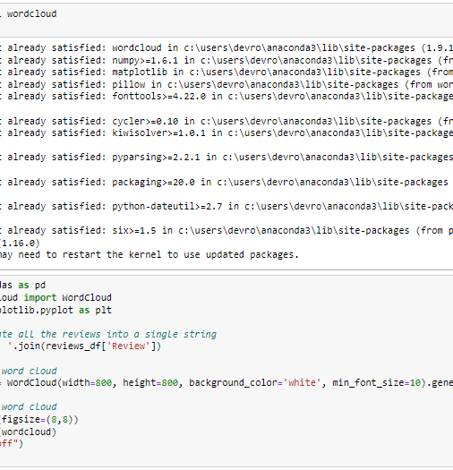
Word Cloud
The magnitude of each word in a word cloud, a graphical representation of text data, shows its frequency or significance. The words that appear the most frequently in a word cloud are displayed with larger font sizes, while the words that appear the least frequently are displayed with smaller font sizes. Word clouds are widely used in spotting patterns, trends, or insights that are not always obvious from a texts.The code generates a word cloud visualization from a collection of text reviews using the wordcloud library. The reviews_df variable is pandas DataFrame containing a column named 'Review' that contains the text of each review.
The reviews are concatenated into a single string using the join function. The image's height and width, the color of the backdrop, and the smallest font size are then initialized with the WordCloud object. To create the word cloud, the concatenated text is passed into the generate method of the WordCloud object.
The word cloud image is displayed using the matplotlib imshow function, and the axes function is run with the option "off" to remove the axes from the plot. The resulting image displays the terms that were used the most frequently in the reviews, with the magnitude of each word reflecting how often it was used.

Slide 22
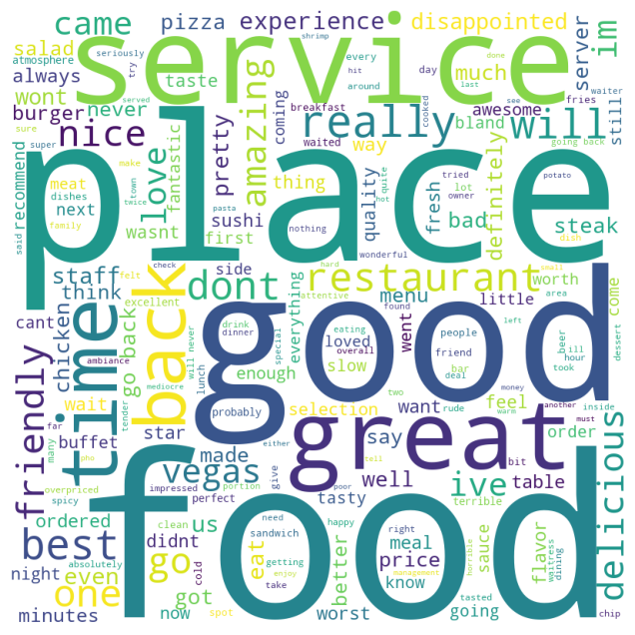
Word cloud

Slide 23
MODEL 3 Random Forest

Slide 24

Random Forest Classifier
A sort of ensemble learning technique called the Random Forest Classifier combines numerous decision trees to produce greater predicting performance than a single decision tree. This approach for supervised learning can be applied to both classification and regression tasks. By picking subsets of the data and features at random, the method builds a decision tree on each subset to produce a forest of them. Each decision tree in the prediction forest makes a forecast during the process, and the overall prediction is the average of all the predictions made by the trees. The data and feature randomization contributes to lowering overfitting and improving the generalizability of the model.

Slide 25
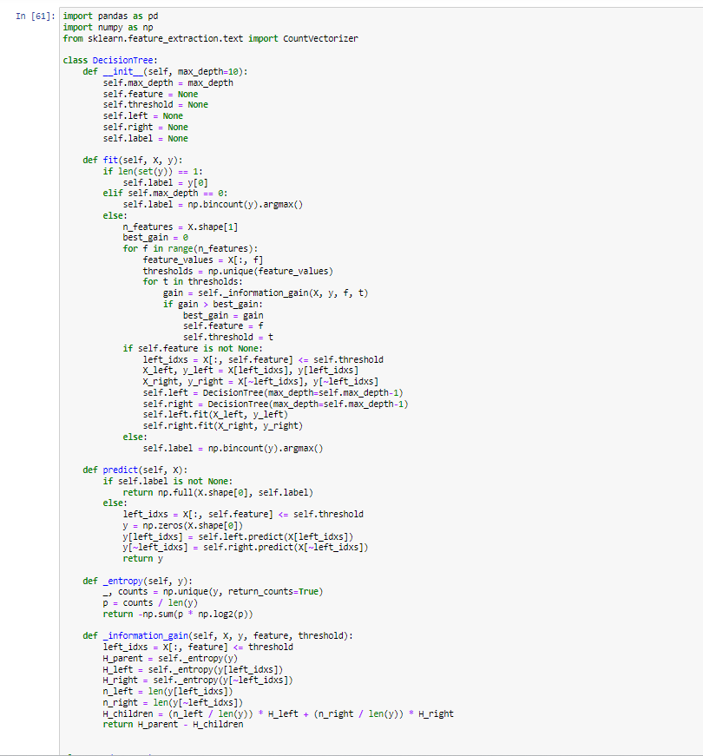
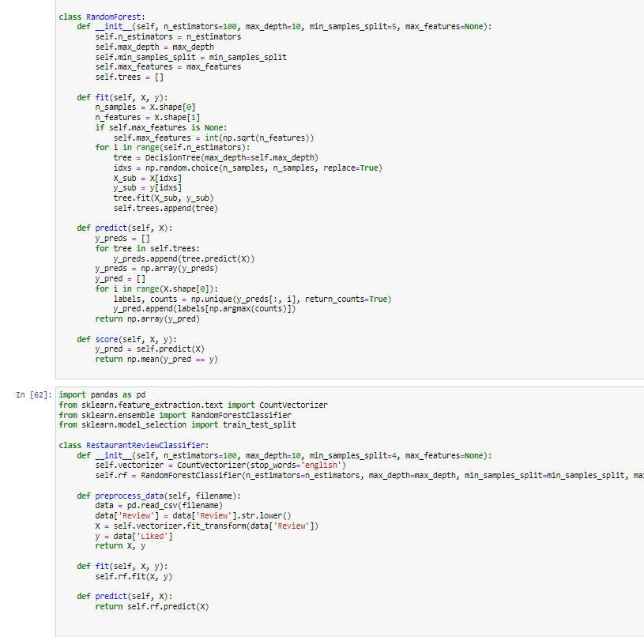
Random Forest Classifier

Slide 26
Random Forest Classifier(Methods) Decision Tree
The constructor function of the DecisionTree class initializes the maximum tree depth (max_depth), the feature index (feature), the feature threshold (threshold), the left and right child nodes (left and right), and the label (label) for leaf nodes.The decision tree is trained using the input data (X) and labels (Y) using the fit method. The node becomes a leaf node with the same label as the input if all of the labels in y are identical. The node changes into a leaf node with the most popular label in y if the maximum depth is achieved. In the absence of it, the algorithm attempts to divide the data using the feature that offers the greatest information gain.
It calculates the information gain, loops through each feature and each distinct value for that feature, and then notes the best feature and threshold that maximizes information gain. The data is split into left and right child nodes and the fit procedure is recursively run on each child node once the best feature and threshold have been identified.Using the trained decision tree, the predict method takes in new data X and provides the expected labels. It returns the label for that node if it is a leaf node. If not, the data is divided according to the feature and threshold, and the predict algorithm is repeatedly called on the left and right child nodes.
The input labels' entropy is determined by the _entropy technique. The information gain of splitting the data on a specific feature and threshold is determined using the _information_gain method. The number of examples in each child node, n_left and n_right, as well as the entropies of the parent node H_parent, the left and right child nodes H_left and H_right, are all calculated. The information gain is represented as the difference between the entropies of the parent and child nodes, weighted by the number of examples in each child node.

Slide 27
Random Forest Classifier(Methods) Random Forest Restaurant review classifier
The fit function initializes and fits several instances of the DecisionTree class to create a Random Forest. Using the max_features hyperparameter, each tree is trained using a random subset of the training data. Predict produces an array of predicted class labels for each test sample after receiving a matrix of test data X. A majority vote of the anticipated labels for each tree in the forest is used to determine this. The scoring technique then determines the predictive accuracy using the supplied test data (X) and true labels (Y).
The DecisionTree class, which is described in the preceding slide, is used in the implementation.
Restaurant Review Classifier is a class that classifies restaurant reviews as positive or negative depending on whether the reviewer enjoyed the establishment or not using a random forest method. The class employs various techniques:The random forest classifier's hyperparameters are specified via the __init__ function, which also initializes the class.
preprocess_data: Reads data from a CSV file and preprocesses it by making all text lowercase and turning it into a word count matrix using a CountVectorizer.
Fit: Adjusts the input data to the random forest classifier.
utilizes the fitted random forest classifier to predict the labels for the input data.

Slide 28
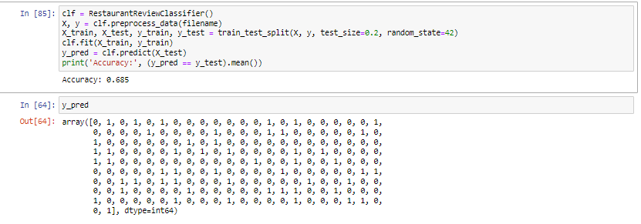
Results
We could see that accuracy is 68%

Slide 29
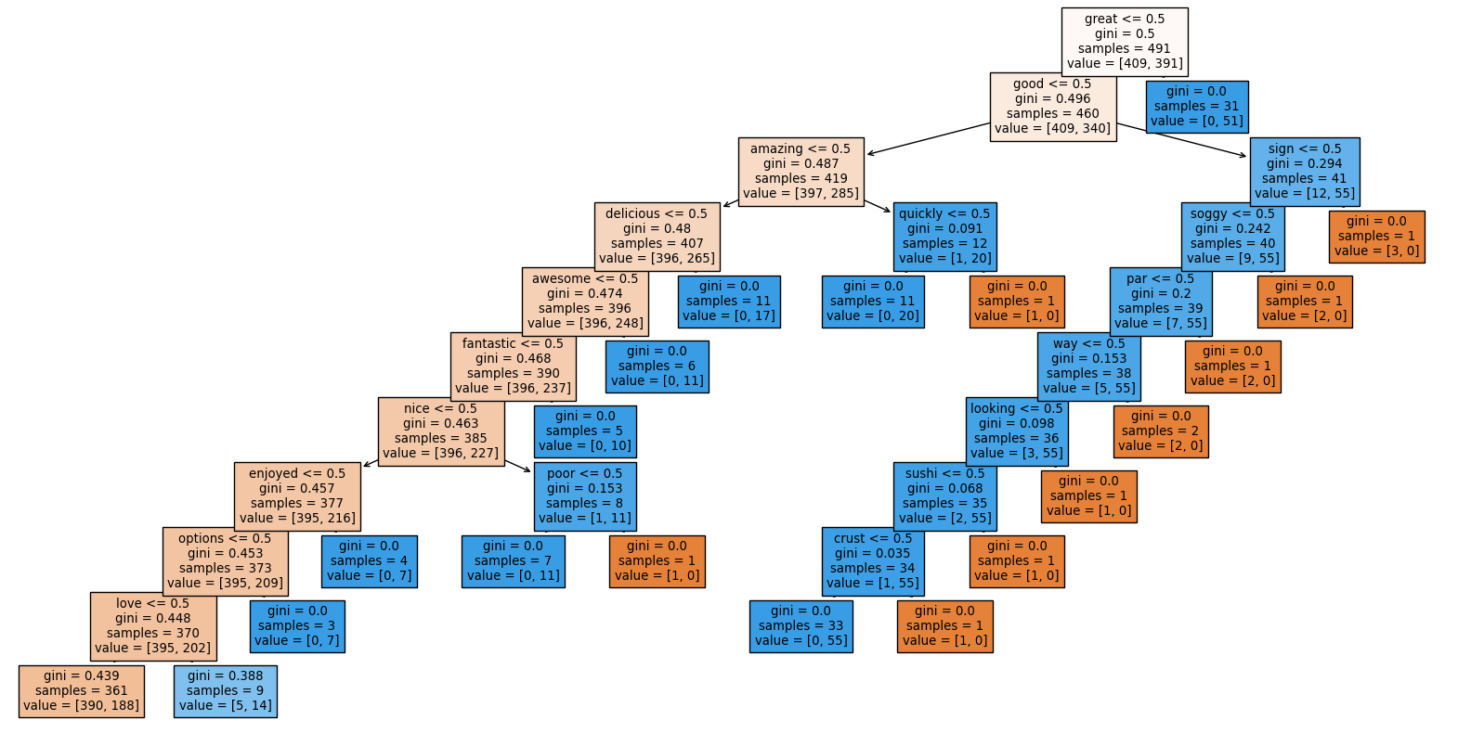
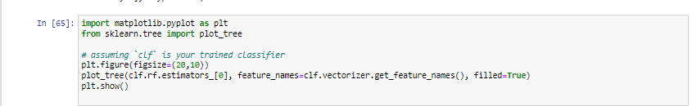
VISUALIZATION

Slide 30
ACCURACY SCORE FOR THREE MODELS
 | Model 1 Naive Bayes | Model 2 Logistic Regression | Model 3 Random Forest
Accuracy Score | 0.72 | 0.74 | 0.684
Because the restaurant review dataset is very small and straightforward and because the elements crucial for identifying whether a review is positive or negative are easily observable, all three models exhibit comparable performance. All three models are also reasonably potent machine learning algorithms that excel at a variety of tasks, including sentiment analysis.

Slide 31

APPLICATIONS
Our models can be applied for any of the restaurant reviews to find out the positive and negative reviews and the most used words in the reviews, this can help thee management to figure out their strong and weak areas and can use it for the development of the restaurant by enhancing the strong points and improving the weak point. We categorize the review and show the best category of the restaurant using the bag of words while processing the reviews, and show the best category the restaurant is reviewed for (like most of reviews has written about hygiene or food etc)

Slide 32

CONTRIBUTION
Devi Vara Prasad Rongala:
Data Preprocessing
Logistic Regression
Decision Tree, Random Forest
Naïve Bayes Classifier
Word Cloud

